Slide 1
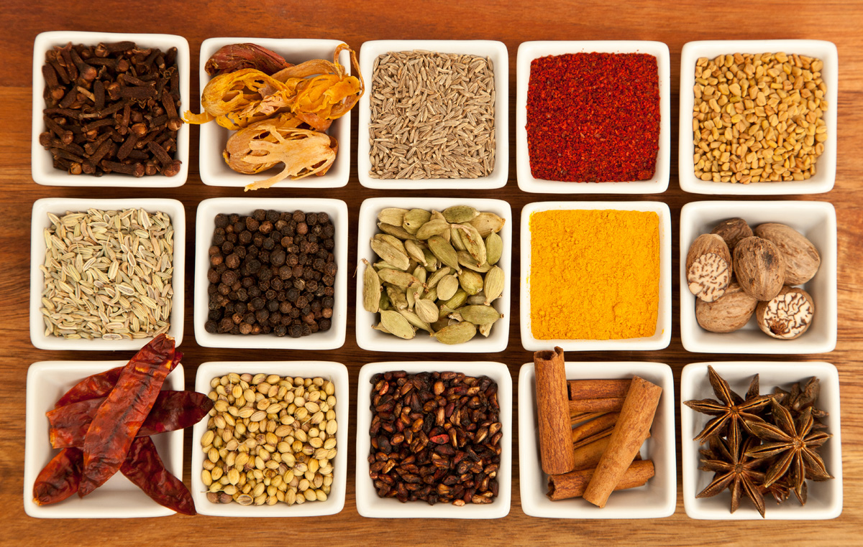
Where to open an Indian restaurant in Ireland?
Capstone Project for the IBM Data Science course
Tamela Maciel, June 2020
Image credit: Joe mon bkk, Wikimedia Commons

Slide 2
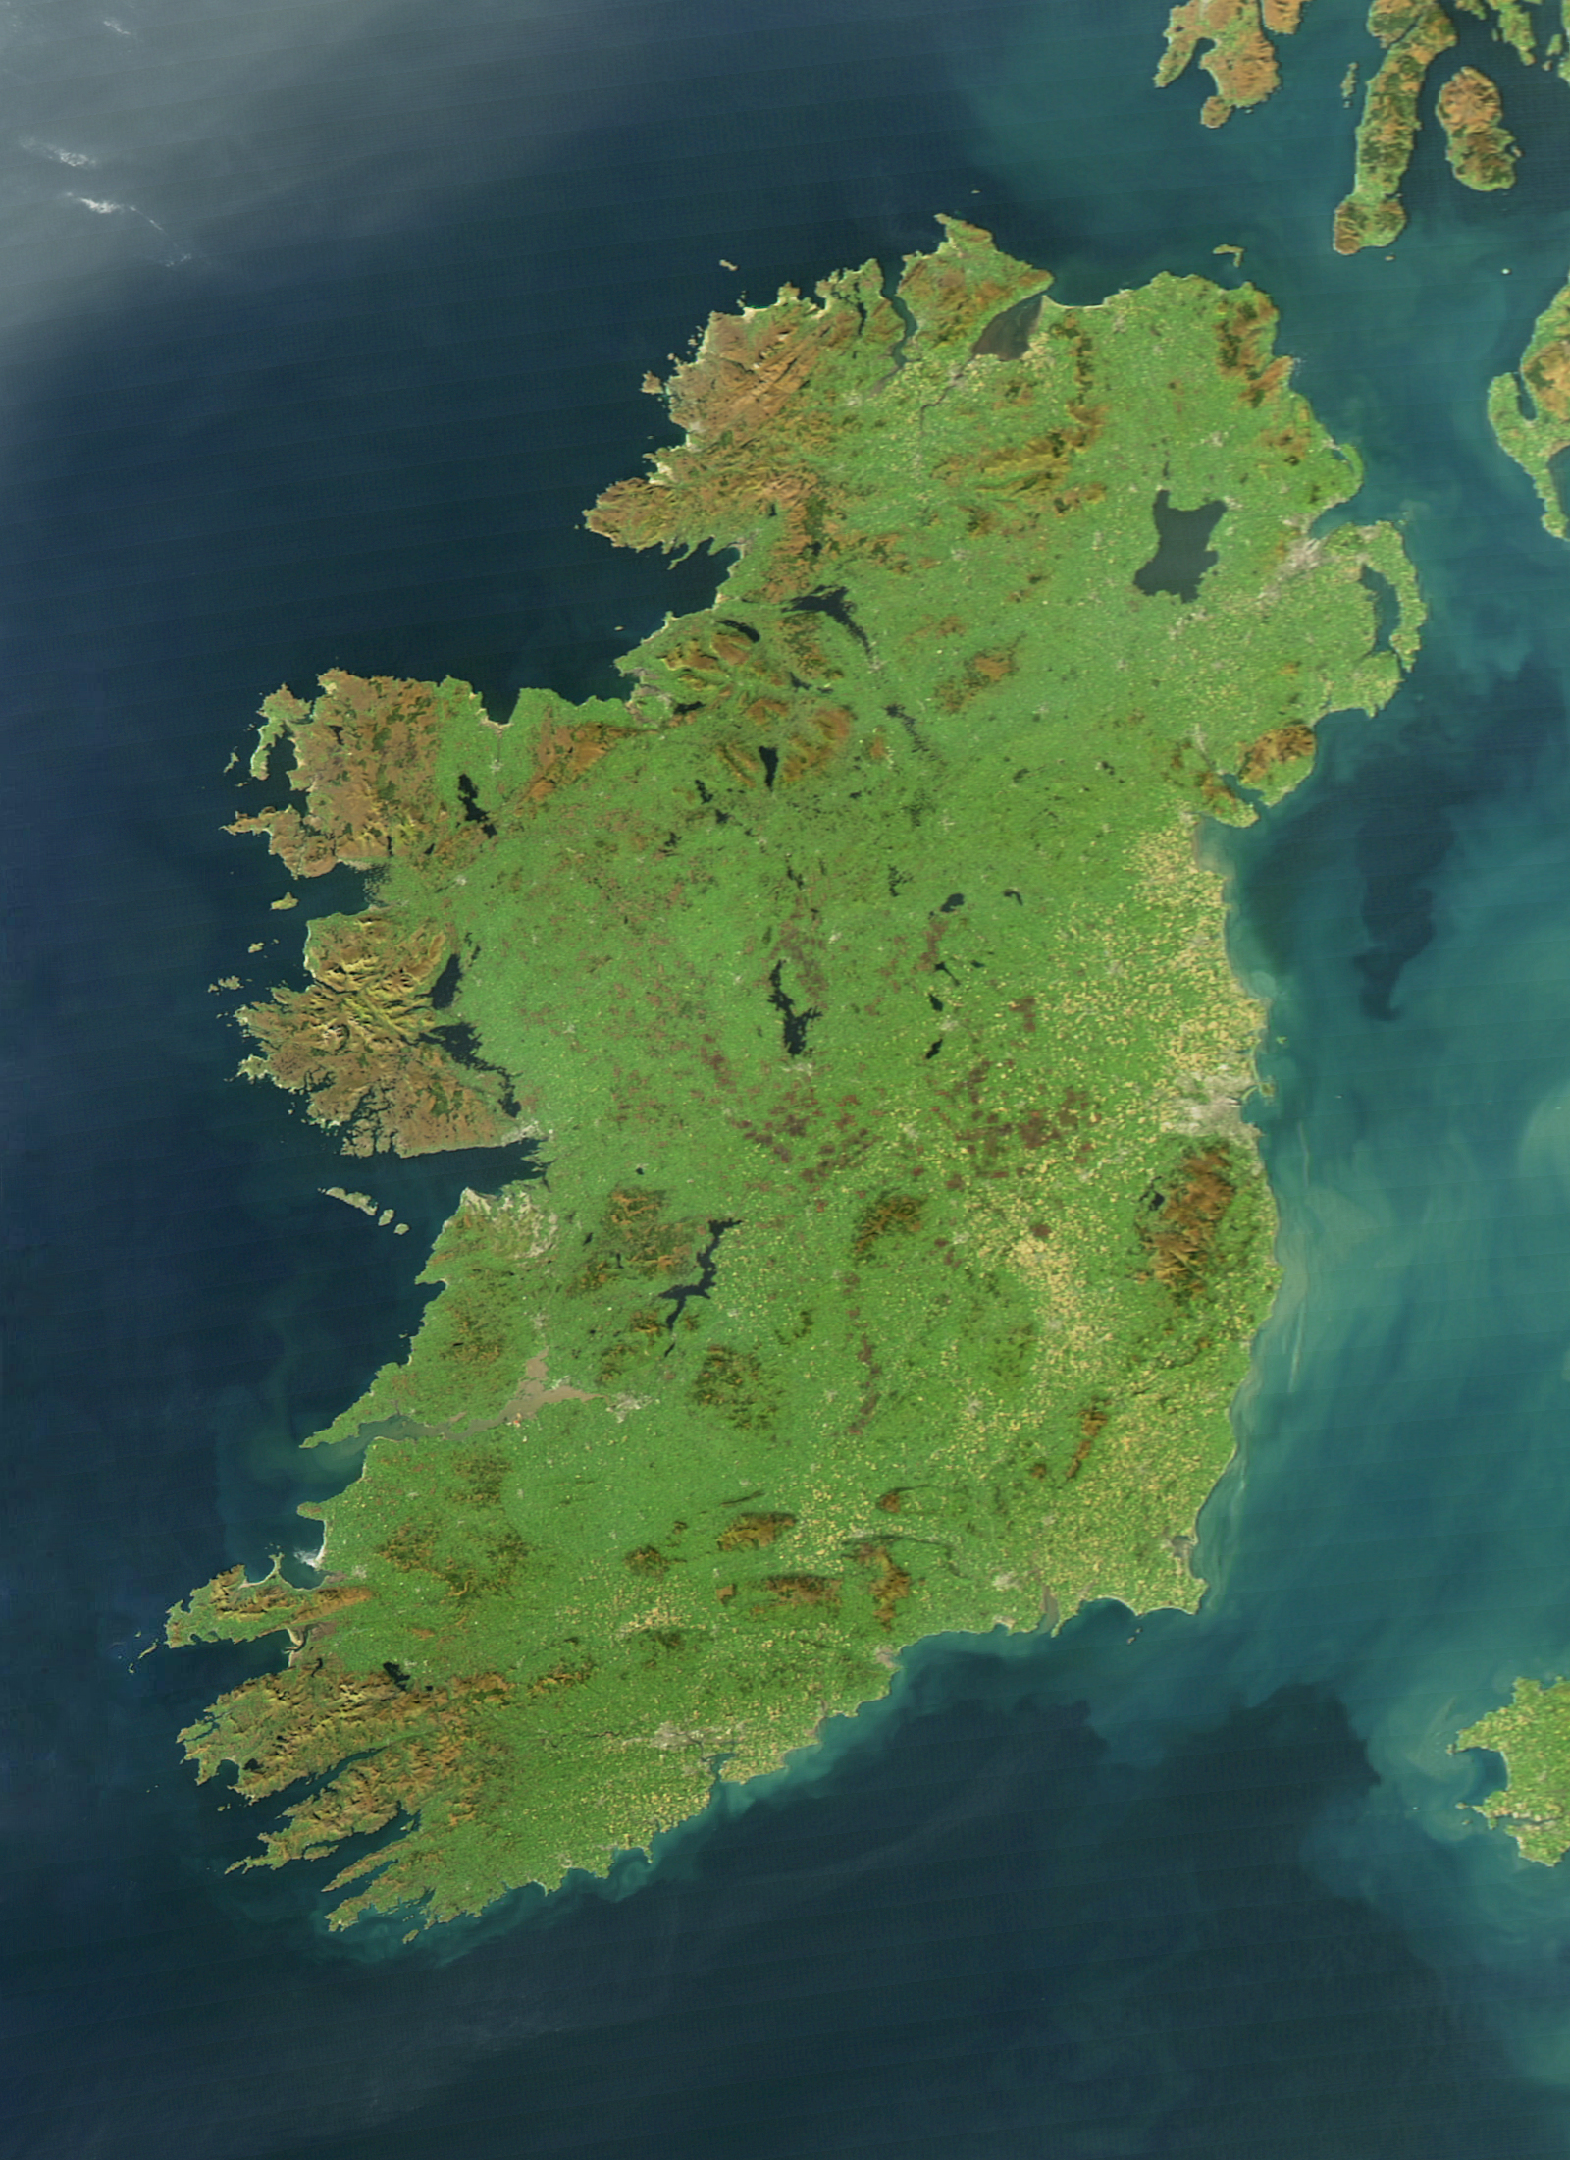
Where to open an Indian restaurant in Ireland?
Our client runs several successful Indian restaurants in Leicester.
Now seeking opportunities to expand into Ireland.
Three criteria for a successful new Indian restaurant:
A city in Ireland that is similar or larger in relative size compared to Leicester.
A relative lack of Indian restaurants in that city.
A relatively high proportion of residents who are Asian (non-Chinese).
Image credit: Jeff Schmaltz, NASA Earth Observatory

Slide 3
Data – Acquisition and Cleaning
Data source | Key info
Leicester population from 2011 UK census, Wikipedia table Irish urban populations from 2016 Irish census, Wikipedia table City centre locations from Nominatim, via python geopy.geocoders | All Irish cities of similar or larger relative size to Leicester, and their locations
Ethnicity of Irish residents, by administrative county, from Central Statistics Office website Administrative county boundaries from data.gov.ie | Irish cities ranked by the percentage of Asian (non-Chinese) residents in their county
Restaurant frequency, location, and type, per city and ranked by popularity, from the Foursquare API | Top restaurants per Irish city (range from 3 to 47 restaurants)
Final dataset:
13 most populous Irish cities, with 17 key features ranging from population, demographics, and restaurants

Slide 4
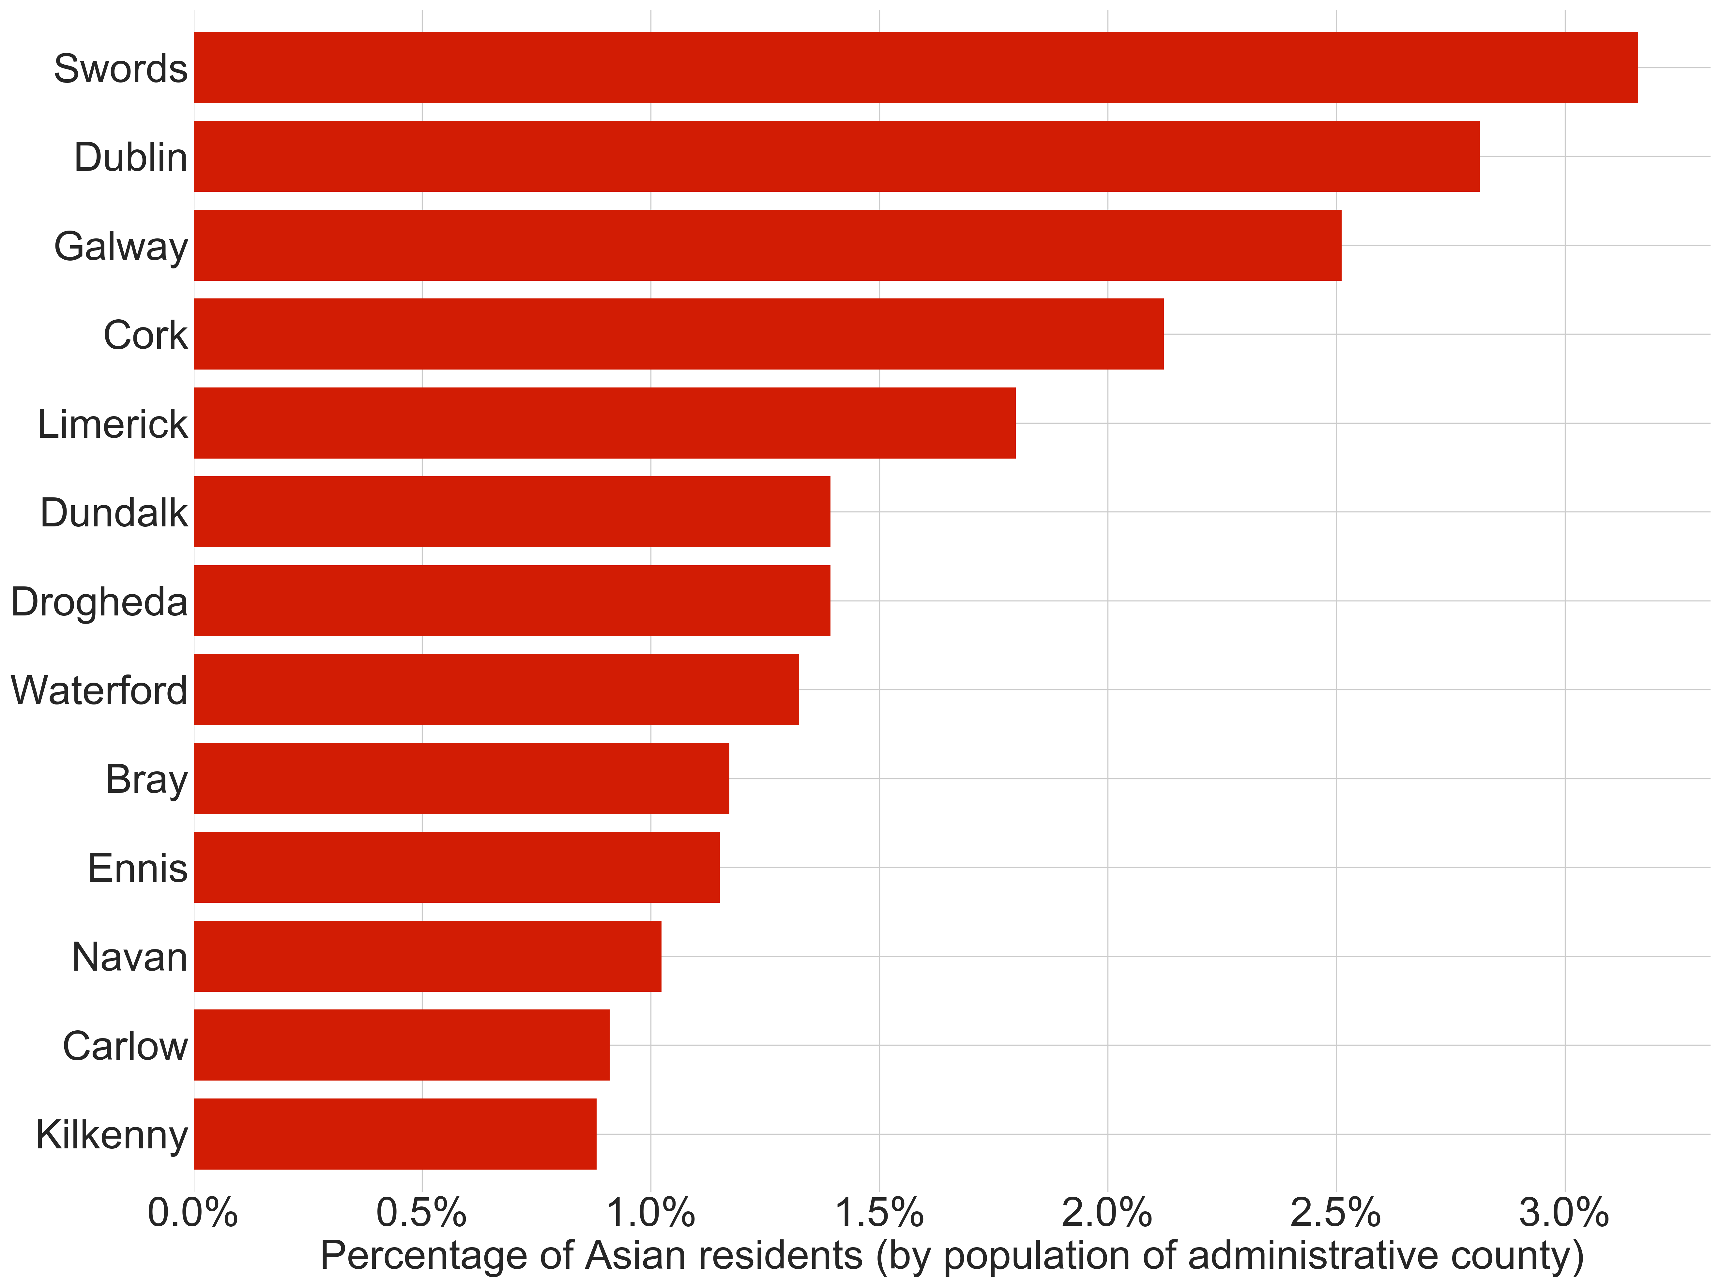
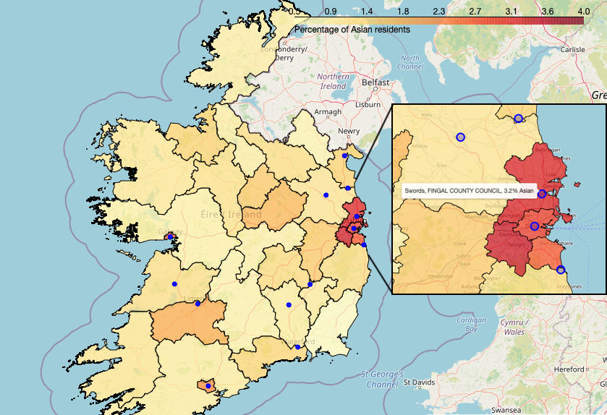
Exploratory Analysis
Proportion of Asian (non-Chinese) residents across 31 administrative counties
Cities mapped to counties according to county boundaries
Percentage of Asian (non-Chinese) residents within the administrative county of the 13 most populous cities.
Choropleth of the percentage of Asian residents per county.
The 13 most populous cities are shown in blue.

Slide 5
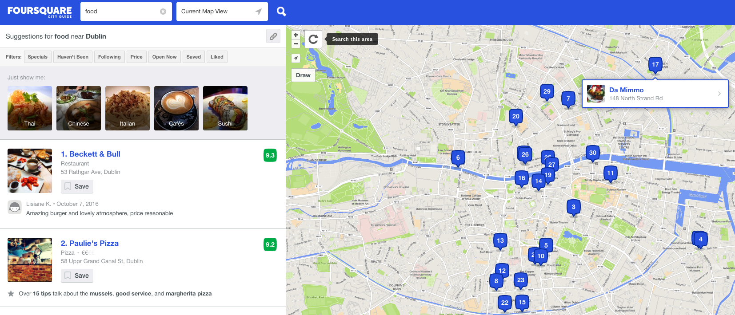
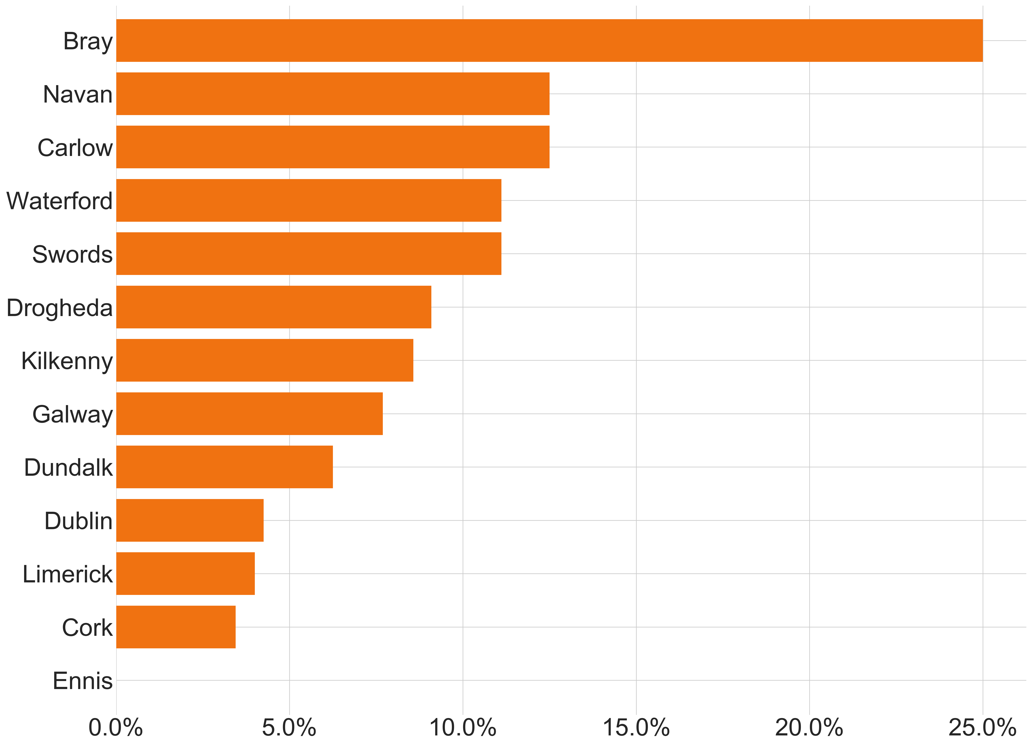
Exploratory Analysis
Foursquare food venues, cleaned and analysed
252 restaurants across 13 Irish cities
7.1% Indian restaurants in total
Percentage of Indian restaurants within 1.5 kilometres of the centre of the 13 most populous cities.

Slide 6
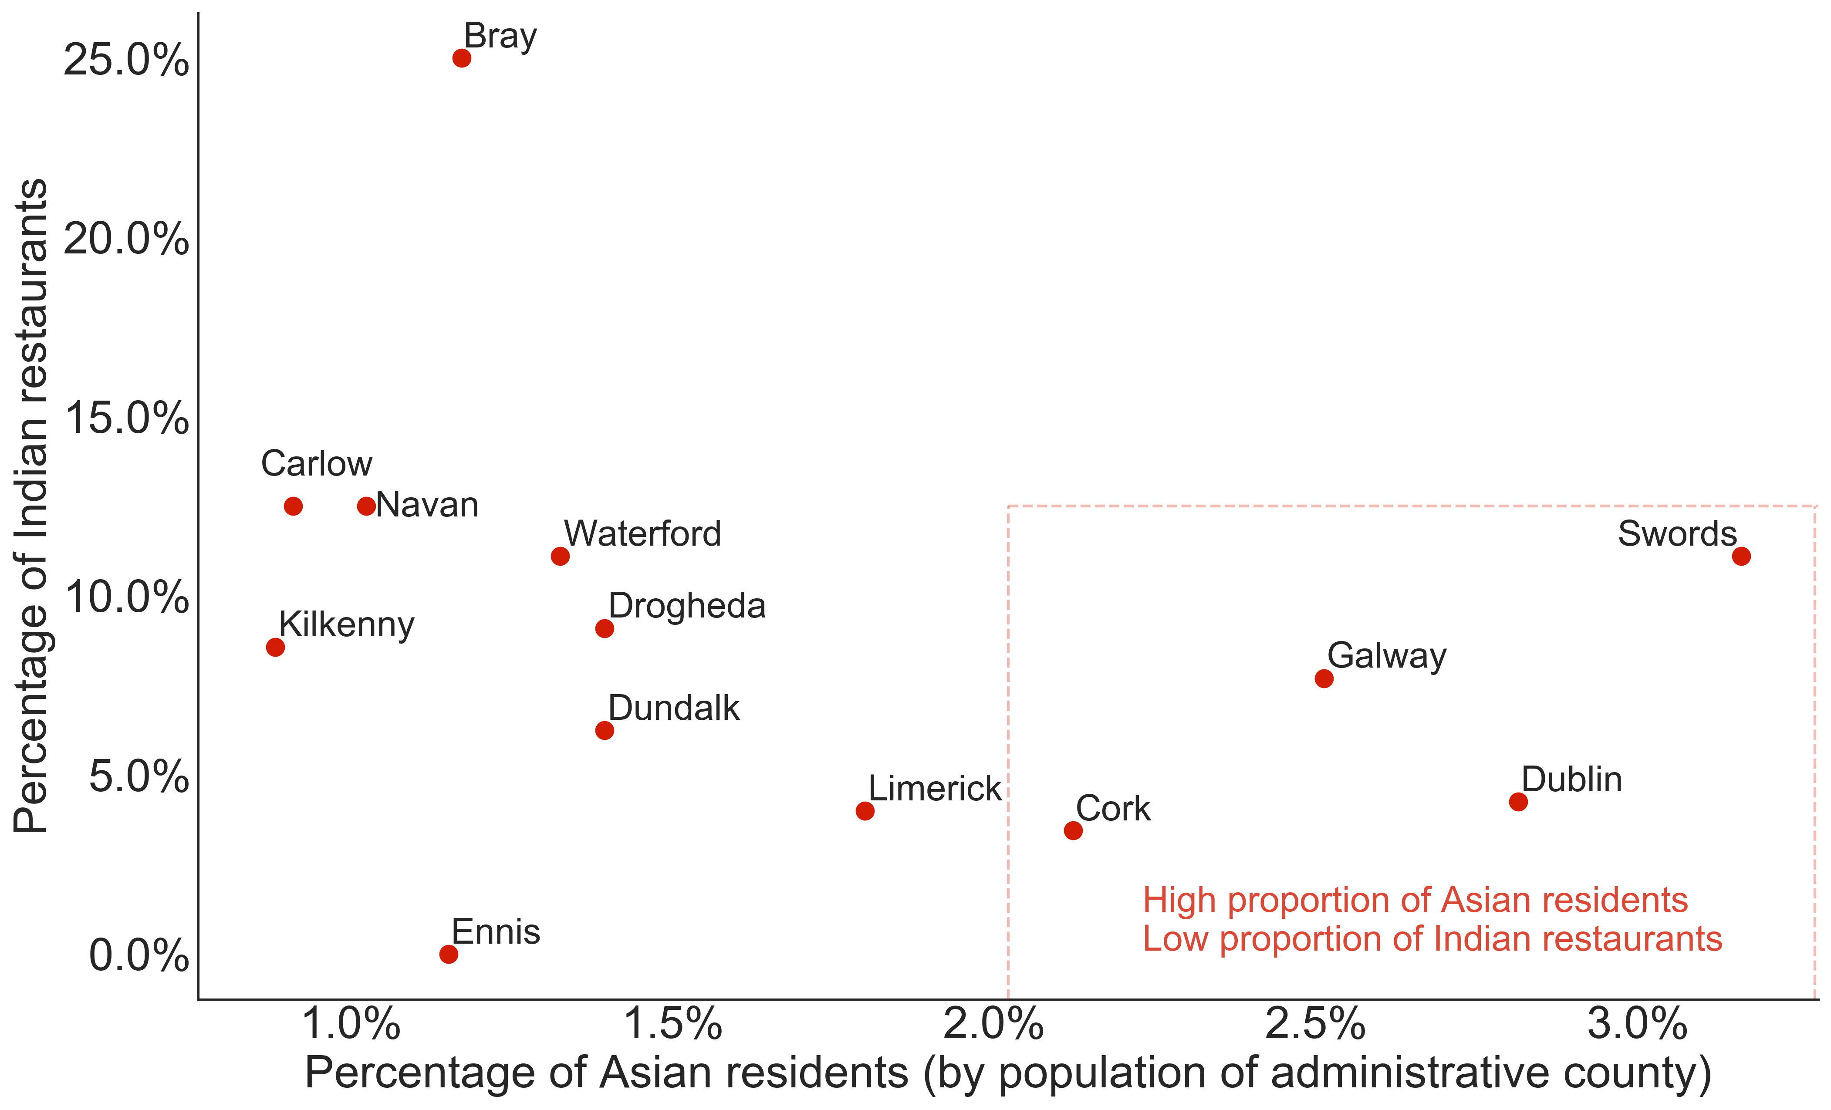
Exploratory Analysis
The percentage of Asian residents and Indian restaurants for the 13 most populous cities
Shortlist of cities that meets the client’s three criteria:
Swords
Dublin
Galway
Cork

Slide 7
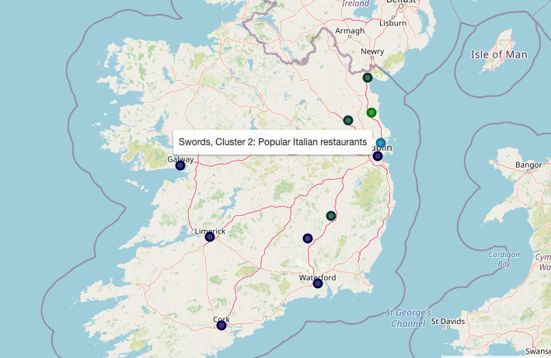
City Clustering by Restaurants
K-means clustering of the frequency of 30 unique types of restaurants, per city
Dropped 2 cities with <5 restaurants
4 clusters for in the least error per cluster
Cluster | No. of cities | Cities | Profile description
1 | 1 | Drogheda | Drogheda, popular generic and Mediterranean restaurants
2 | 1 | Swords | Swords, popular Italian restaurants
3 | 3 | Carlow, Navan, Dundalk | Mid-size cities, popular Chinese-Asian restaurants
4 | 6 | Dublin, Cork, Galway, Limerick, Waterford, Kilkenny | Larger cities, popular generic ‘restaurants’

Slide 8
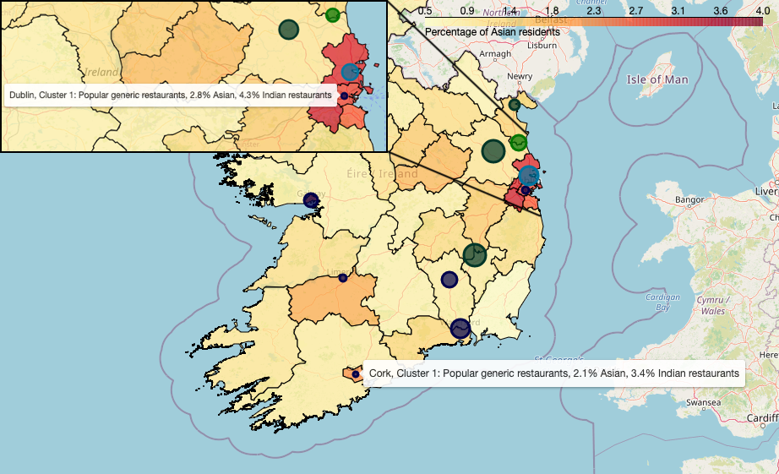
Recommendations
Best cities in which to open a new Indian restaurant
Based on cluster profiles, and demographics for each city and county
Top three recommendations:
Dublin: 2.8% Asian population, only 2 Indian restaurants out of 47 (4.3%)
Swords: 3.2% Asian population, only 1 Indian restaurant out of 9 (11.1%)
Cork: 2.1% Asian population, only 1 Indian restaurant out of 29 (3.4%)
Two runners-up:
Galway: 2.5% Asian population, only 3 Indian restaurants out of 39 (7.7%). But 3rd most common restaurant is an Indian
Limerick: 1.8% Asian population, only 1 Indian restaurant out of 25 (4%)
Choropleth of the percentage of Asian per administrative county. The final 11 cities are coloured by restaurant cluster. The circle size indicates the percentage of Indian restaurants.

Slide 9
Future investigations
This study limited to demographics and restaurant data on a city-level basis.
Our recommendations are a starting point for further analysis that might include:
Property prices and business rates per city
Average disposable income per city
Neighbourhood demographics for a chosen city
Neighbourhood restaurant profile for a chosen city
Historic restaurant data for a chosen city
(have Indian restaurants opened and failed before?)
Image credit: Joe mon bkk, Wikimedia Commons

